Slide 1
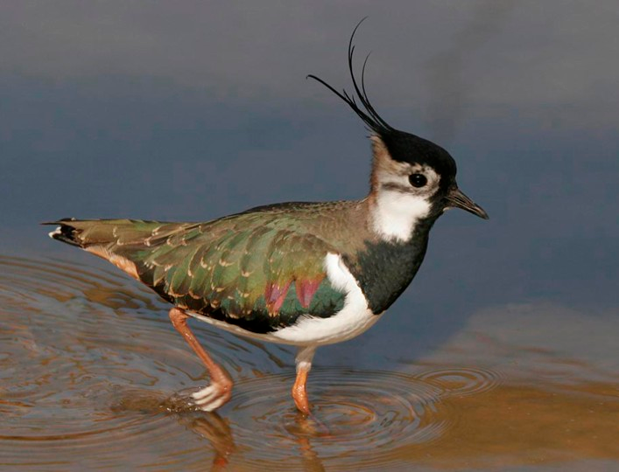
Statistics: A quick refresher

Slide 2
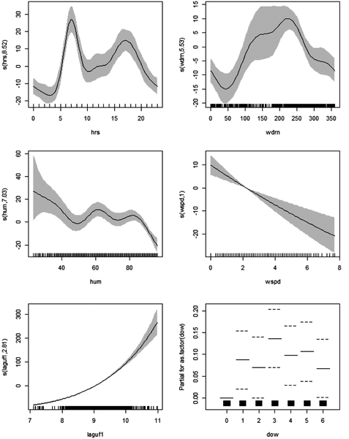
Part 1: Philosophy of stats

Slide 3



Did you drink coffee this morning?
Utterly trivial and simple question.
The response will be yes or no (1 or 0).
Given your answer, the more interesting question is why did you drink coffee (or not)?
There is some unknown probability that you will drink coffee, which is determined by a set of some unknown influences.
$$y_{i}∼binomial(p_{i})$$
$$p_{i}=Xβ$$

Slide 4
Why did you drink coffee this morning (or not)?
No one randomly chooses to drink coffee (no “lol so random” crap here).
That decision is determined based on an entire process! E.g.;
Do you parents drink coffee?
Did you watch TV where mature characters drank coffee?
Did you want to emulate these characters?
Are you from a culture where drinking coffee in the morning is normal?
Do you drink tea instead of coffee?
Are you hungover?
Do you believe drinking coffee helps with a hangover?
Did you see a butterfly this morning, which reminded you of your grandmother’s room which had butterflies in the wallpaper, and your grandmother used to grind coffee by hand, and did you become nostalgic for your grandmothers coffee?
And so, so, so many more potential variables which drove you to your decision this morning.
The aim of causal statistics is to try and capture the true causal relationships of this process.

Slide 5
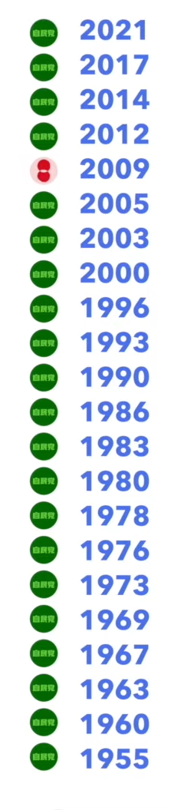
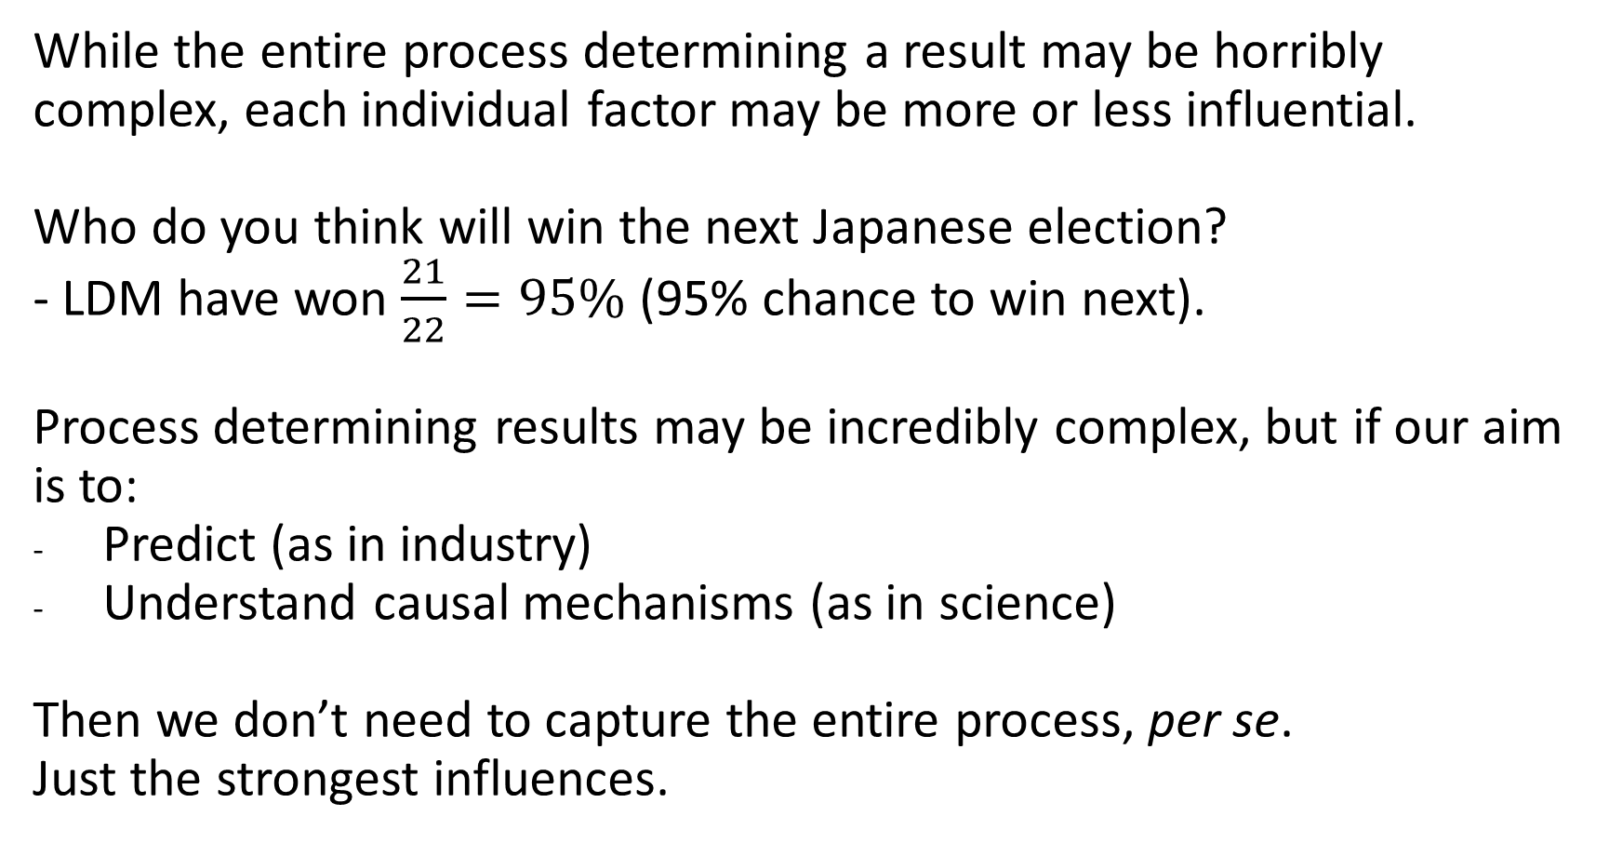
First among equals
While the entire process determining a result may be horribly complex, each individual factor may be more or less influential.
Who do you think will win the next Japanese election?
- LDM have won $\frac{21}{22}=95\%$ (95% chance to win next).
Process determining results may be incredibly complex, but if our aim is to:
Predict (as in industry)
Understand causal mechanisms (as in science)
Then we don’t need to capture the entire process, per se.
Just the strongest influences.

Slide 6
From a culture where drinking coffee in the morning is normal?
parents drink coffee
Began drinking coffee for whatever reason 10 years ago, but has now formed a habit of drinking coffee?
Watched TV where mature characters drank coffee?
Was nostalgic for grandmother's coffee?
Wanted to emulate characters?
Grandmother used to grind coffee by hand?
Drinks tea instead of coffee?
Grandmother’s room had butterflies in the wallpaper?
Believe drinking coffee helps with a hangover?
Saw a butterfly this morning?
Is hungover?

Slide 7
Think before you run!!!
Adding covariates (i.e., “factors”) to a model is easy.
There are tools available to help you choose which the “most important” variables are (but these carry huge risks).
Thinking about what to add to a model is much harder – but this is why you’ve had four years to learn biology!
Do not disregard your biological understanding just to fit a model!
The aim of causal statistics is to try and capture the true causal relationships of this process.

Slide 8
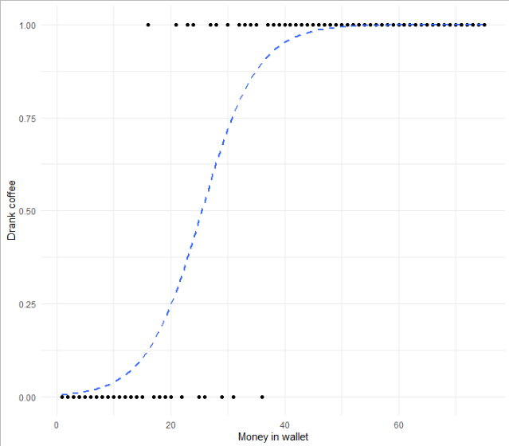

Do you trust my model?
$$\operatorname{Pr}\left(Drink Coffee\right)∝Money in wallet$$
What is the mechanism that causes you to buy a coffee, 100% of the time, if you have > £50 in your wallet?
The aim of causal statistics is to try and capture the true causal relationships of this process.

Slide 9

The Monkey’s Paw
The Monkey’s Paw is a short story from 1902 by W. W. Jacobs.
Brief summary:
A suitably middle-class family come into possession of a wish granting monkey paw. They wish for money to buy a house. The husband goes to work the next morning but dies on the job. The foreman visits his wife with his life insurance
Relevance to stats:
Any poorly specified model is likely to lead to dire consequences, so models must be tailored with great care.

Slide 10
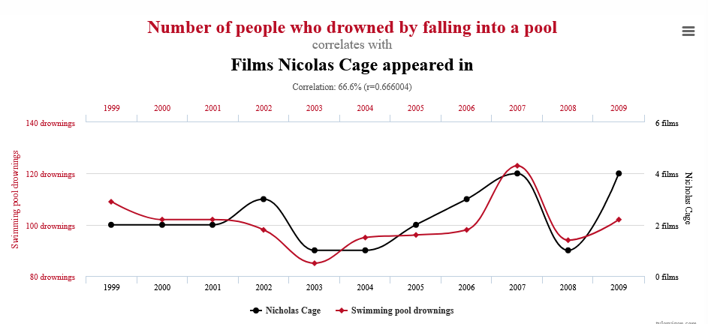
Beware the statistical Monkey’s Paw

Slide 11
Part 2: To save species you must know some stats

Slide 12
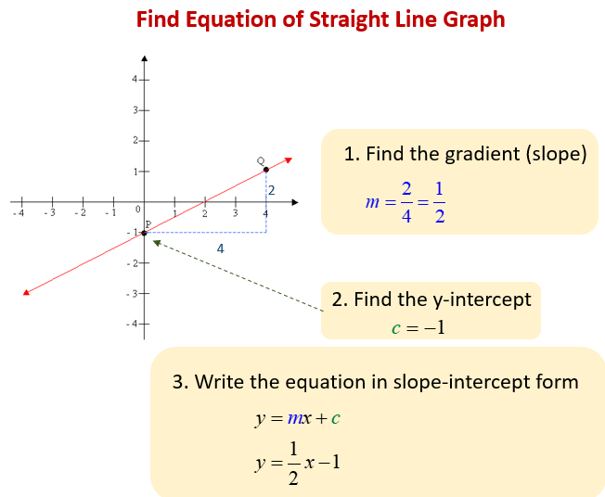
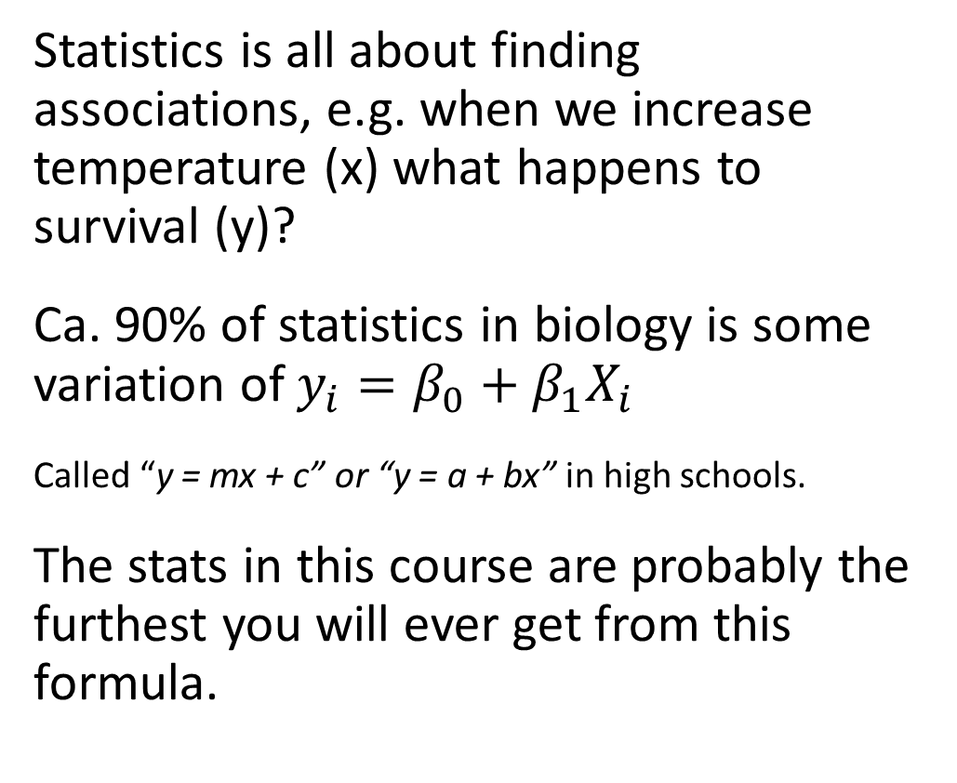
Stats: making the simple seem really complicated
High-school maths revision
Statistics is all about finding associations, e.g. when we increase temperature (x) what happens to survival (y)?
Ca. 90% of statistics in biology is some variation of $y_{i}=β_{0}+β_{1}X_{i}$
Called “y = mx + c” or “y = a + bx” in high schools.
The stats in this course are probably the furthest you will ever get from this formula.

Slide 13
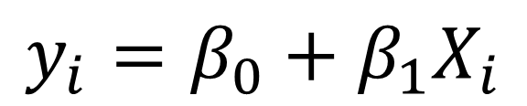
Statistics and data
$$y_{i}=β_{0}+β_{1}X_{i}$$
Continuous (e.g. height)
Observed
Grouped
(e.g. eye colour)
Data
Unobserved
“Parameter”

Slide 14
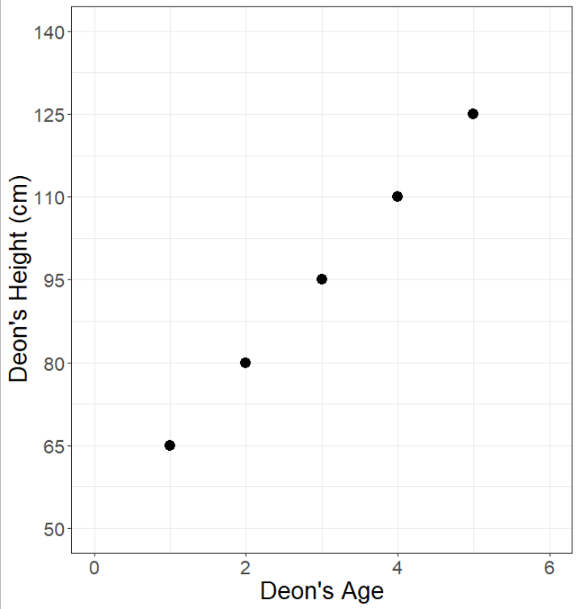

Doing “stats” by hand
Remember your straight line equation:
$$y_{i}=β_{0}+β_{1}X_{i}$$
$y_{i}$ = Deon’s height
$X_{i}$ = Deon’s age
$β_{0}$ = y-intercept (I was $β_{0}$ tall when I was born)
$β_{1}$ = Slope (aging 1 year increased my height by $β_{1}$)
Observed data
Unobserved data

Slide 15
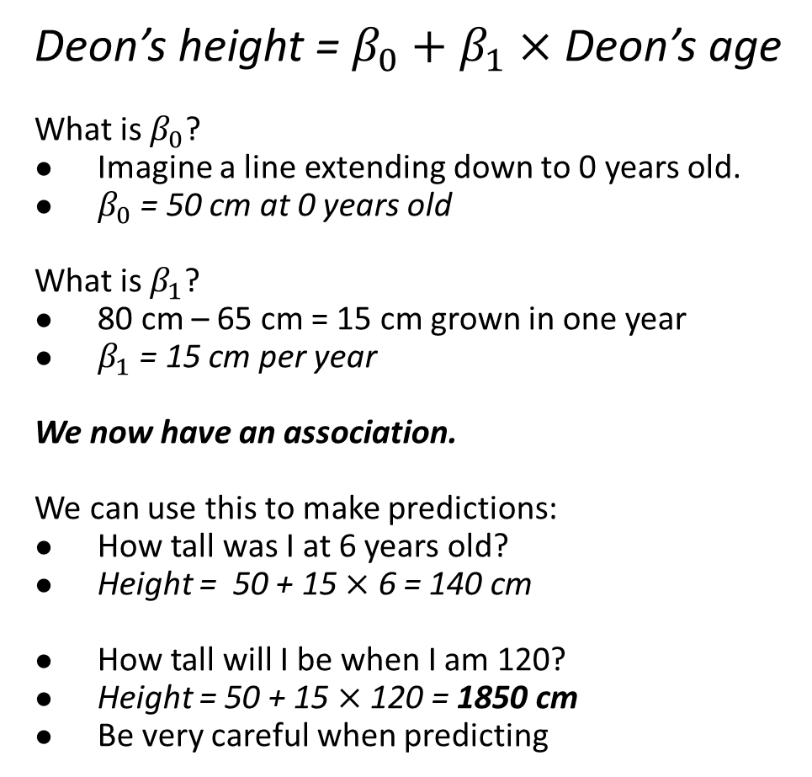
“Stats” by hand
Deon’s height = $β_{0}+β_{1}×$ Deon’s age
What is $β_{0}$?
Imagine a line extending down to 0 years old.
$β_{0}$ = 50 cm at 0 years old
What is $β_{1}$?
80 cm – 65 cm = 15 cm grown in one year
$β_{1}$ = 15 cm per year
We now have an association.
We can use this to make predictions:
How tall was I at 6 years old?
Height = 50 + 15 $×$ 6 = 140 cm
How tall will I be when I am 120?
Height = 50 + 15 $×$ 120 = 1850 cm
Be very careful when predicting
You will never see data with such a “clean” relationship in the real world. If you do, it’s almost certainly fake.

Slide 16
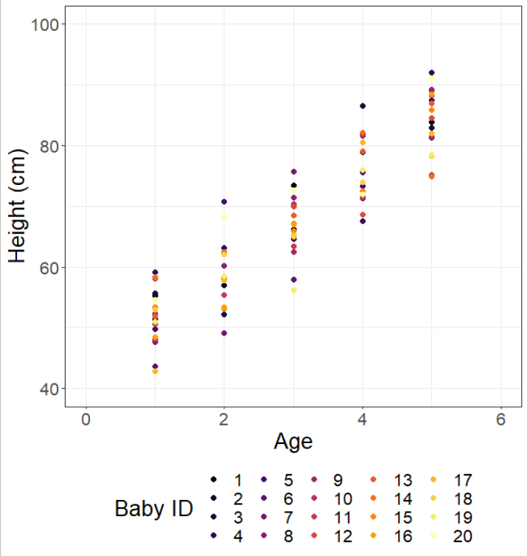
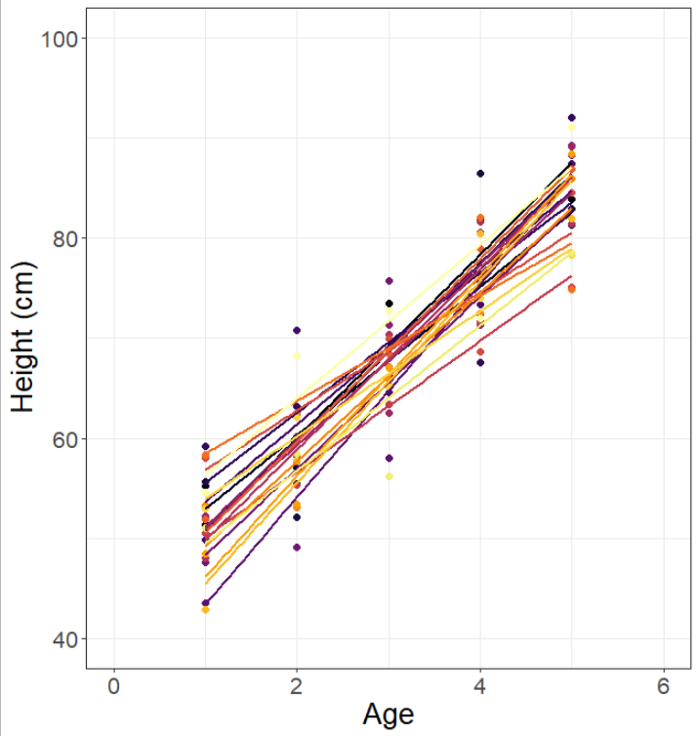
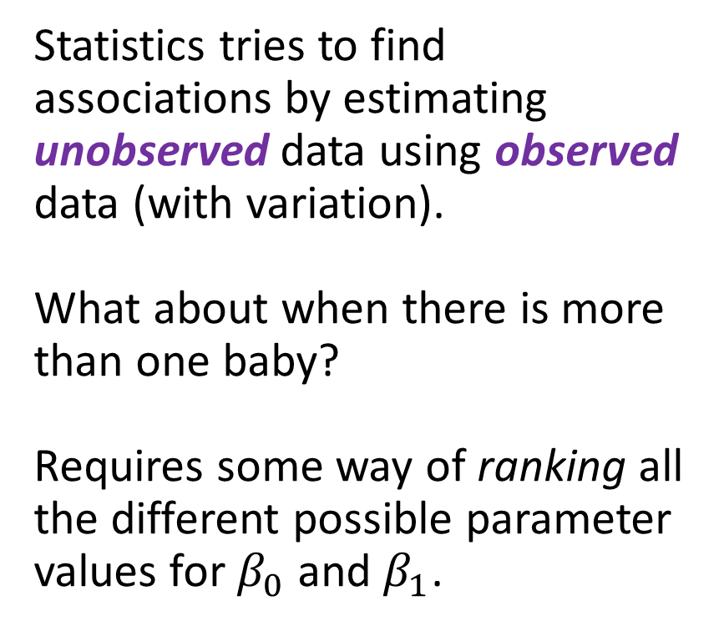
More realism
Statistics tries to find associations by estimating unobserved data using observed data (with variation).
What about when there is more than one baby?
Requires some way of ranking all the different possible parameter values for $β_{0}$ and $β_{1}$.

Slide 17
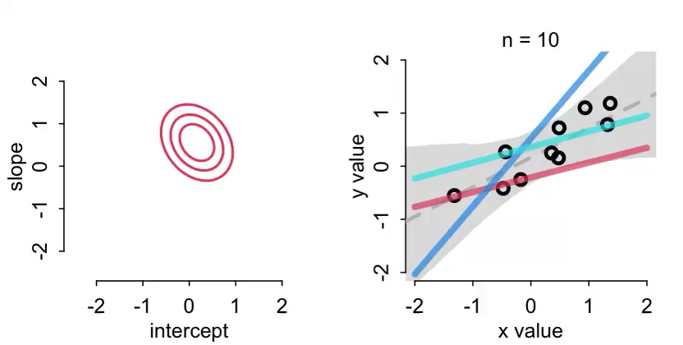
Maximum Likelihood Estimate and Optimizers
An “algorithm”(left intentionally vague) which tries different values for all parameters. It “choses” those values which best match the observed data.

Slide 18
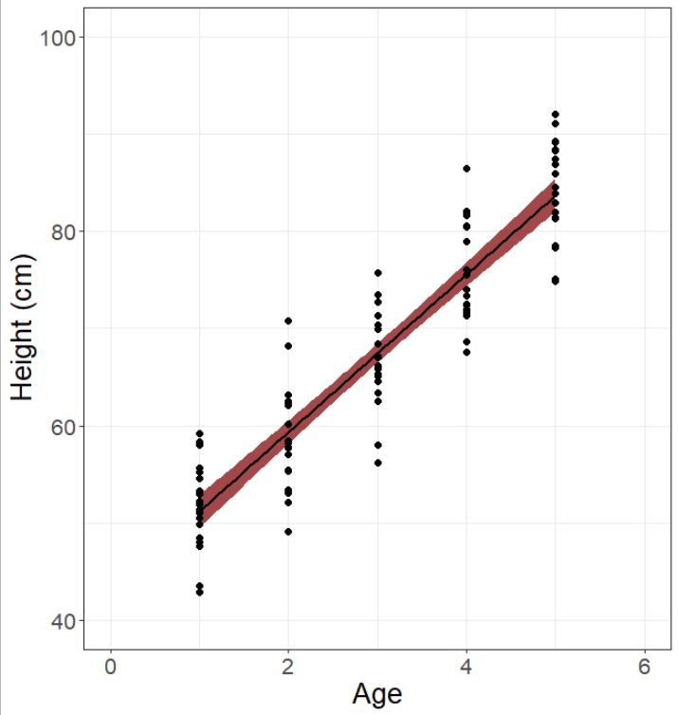
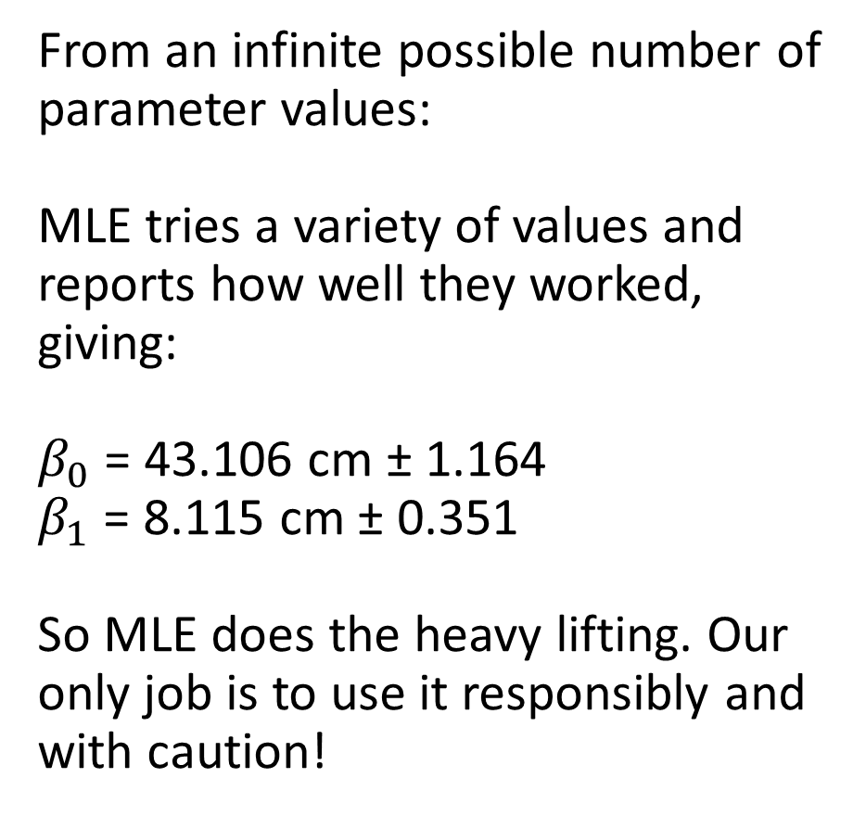
So what does MLE estimate? (Abstract summary)
From an infinite possible number of parameter values:
MLE tries a variety of values and reports how well they worked, giving:
$β_{0}$ = 43.106 cm ± 1.164
$β_{1}$ = 8.115 cm ± 0.351
So MLE does the heavy lifting. Our only job is to use it responsibly and with caution!

Slide 19
Did you drink coffee this morning?
Utterly trivial and simple question.
The response will be yes or no (1 or 0).
Given your answer, the more interesting question is why did you drink coffee (or not)?
There is some unknown probability that you will drink coffee, which is determined by a set of some unknown influences.
Let’s update this for the baby example
$$y_{i}∼binomial(p_{i})$$
$$p_{i}=Xβ$$

Slide 20
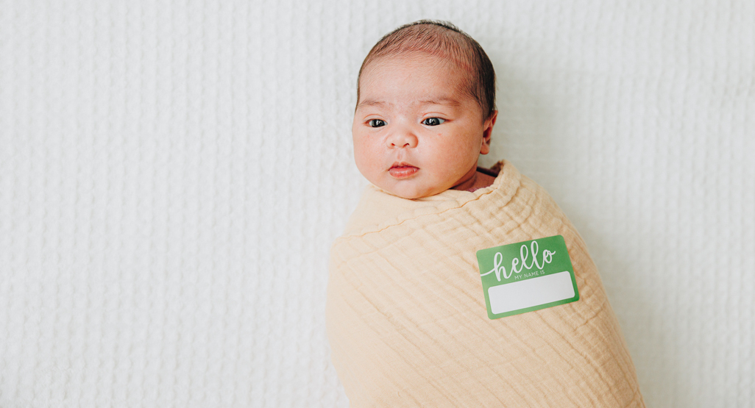
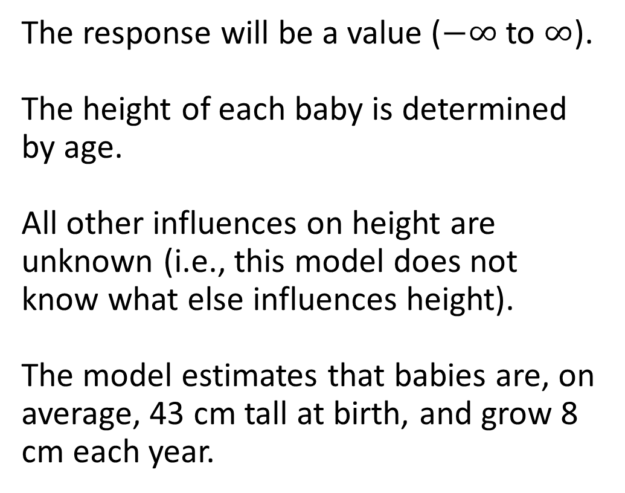



How quickly do babies grow?
The response will be a value ($−∞$ to $∞$).
The height of each baby is determined by age.
All other influences on height are unknown (i.e., this model does not know what else influences height).
The model estimates that babies are, on average, 43 cm tall at birth, and grow 8 cm each year.
^ This is a human baby
$$y_{i}∼Normal(μ_{i}, σ)$$
$$μ_{i}=β_{0}+β_{1}×Age_{i}+ ϵ_{i}$$
$μ_{i}=\text{43}+8×Age_{i}$ $+ ϵ_{i}$

Slide 21
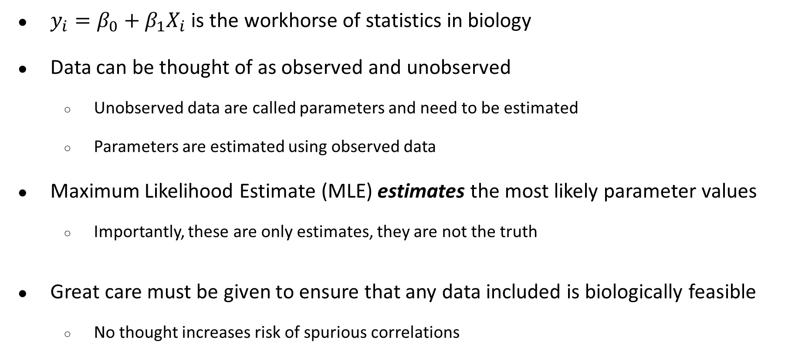
tl;dr
$y_{i}=β_{0}+β_{1}X_{i}$ is the workhorse of statistics in biology
Data can be thought of as observed and unobserved
Unobserved data are called parameters and need to be estimated
Parameters are estimated using observed data
Maximum Likelihood Estimate (MLE) estimates the most likely parameter values
Importantly, these are only estimates, they are not the truth
Great care must be given to ensure that any data included is biologically feasible
No thought increases risk of spurious correlations

